Slide 1
Roles & Responsibilities Status
Stephen Sullivan

Slide 2
AGENDA
Governance, Roles & Responsibilities
NIEMOpen
NTAC
NBAC
NMO
Harmonization Sub-Committee

Slide 3
NIEMOPEN Governance
Reference Document (s):
Open Project Rules: https://www.oasis-open.org/policies-guidelines/open-projects-process/
NIEMOpen Governance: https://github.com/niemopen/oasis-open-project/blob/main/GOVERNANCE.md
List Project Leadership (PGB, NTAC TSC, NBAC TSC) – should be updated to reflect NMO TSC
NIEM Open is overseen by the following committees:
Project Governing Board (PGB): Group responsible for the overall lifecycle or business strategy of the project. Oversees activities such as events, marketing, partnerships, promotion, budget, and so forth.
NIEM Business Architecture Committee (NBAC): A Technical Steering Committee directing the day-to-day activities of the project related to the NIEM Core data model.
NIEM Technical Architecture Committee (NTAC): A Technical Steering Committee directing the day-to-day activities of the project related to NIEM's technical architecture.
NIEMOpen Management Office (NMO): A Technical Steering Committee directly supporting the PGB Chair (s) in execution of the day-to-day activities of the PGB.
Defines Community Roles (Contributors & Maintainers)
Contributors: A Contributor is someone who has agreed to the Contributor License Agreement (CLA) and who makes regular contributions to one or more NIEM Open projects (including but not limited to activities such as documentation, code reviews, responding to issues, participation in proposal discussions, contributing code, etc.). Any person (whether or not an OASIS member or NIEM Open sponsor) may participate in the NIEM Open as a Contributor. The role of contributor is furthermore defined in the OASIS Open Project Rules.
Maintainers: A Maintainer is someone who has agreed to the Contributor License Agreement (CLA) and has been selected by the TSC to oversee one or more components of an NIEM Open project, review code and pull requests, prepare releases, triage issues, and similar tasks. Maintainers and their requisite duties are managed by the TSC. Any person (whether or not an OASIS member or NIEM Open sponsor) may be appointed as a project Maintainer. The role of Maintainer is furthermore defined in the OASIS Open Project Rules.
These should read NIEMOpen
Add NMO

Slide 4


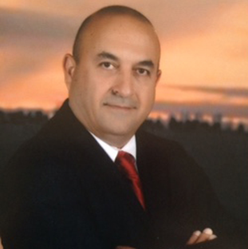








NTAC, NBAC, & NMO TSC Co-Chairs & NIEMOPEN Maintainers
TSC | Approved (TSC CHAIRS)
NMO TSC | Ms. Darcy Staley & Ms. Beth Smalley
NBAC TSC | Mr. Kamran Atri & Mr. Thomas Krul, Mr. Paul Wormeli
NTAC TSC | Dr. Scott Renner & Mr. Brad Bolliger
GitHub Repos | Primary | Alternates
NIEM Open | Ms. Christina Medlin, Mr. Aubrey Beach | Mr. Tom Carlson, Ms. Shunda Louis, Mr. Steve Sullivan (pgb-minutes)
NTAC-Admin | Dr. Scott Renner, Mr. Brad Bolliger | Mr. Aubrey Beach, Mr. Tom Carlson, Mr. Jim Cabral, Ms. Christina Medlin, Ms. Shunda Louis
NBAC-Admin | Mr. Steve Sullivan, Mr. Aubrey Beach | Ms. Shunda Louis, Ms. Christina Medlin
NMO-Admin | Ms. Darcy Staley, Mr. Aubrey Beach | Mr. Steve Sullivan, Ms. Shunda Louis
NTAC TSC
NBAC TSC
Christina Medlin
Aubrey Beach
Dr. Scott Renner
Brad Bolliger
NMO
TSC
Steve Sullivan
Darcy Staley

Slide 5
NTAC Governance, Roles & Responsibilities
Reference Document (s):
NIEMOpen Governance: https://github.com/niemopen/oasis-open-project/blob/main/GOVERNANCE.md
NIEM Technical Architecture Committee (NTAC) Governance: https://github.com/niemopen/ntac-admin/blob/main/GOVERNANCE-NTAC.md
Responsibilities: The NTAC is responsible for transforming the business requirements of NIEM into the technical architecture of NIEM Open. This includes:
All technical specifications
Conformance of NIEM model artifacts with those technical specifications
The design (but not the execution) of the NIEM release workflow and artifacts.
A tool strategy, requirements and desiderata for software tools supporting developers who design NIEM-conforming message specifications and/or implement software that creates or consumes NIEM-conforming messages.
The adapter, external, and utility schema documents in the XML Schema representation of the NIEM data model.
NIEM Model Version 6.0 is a specification
Who does this?

Slide 6
NTAC NTAC Governance, Roles & Responsibilities
Outlines Decision Process
For most decisions, the NTAC operates by lazy consensus. The following decisions are made by agreement of the co-chairs:
Appointment of the NTAC voting member as an Expert Voting on the PGB (according to Open Projects Rule 5.1) on a rotating basis.
The NTAC may, at its own discretion, delegate authority on minor technical decisions to Maintainers in the community, including but not limited to:
Tagging of minor versions of a project
Creation and merging/removal of feature branches
Acceptance or rejection of specific defects, feature requests, user stories
Merging of pull requests
Decisions on the following items must be made based on a Simple Majority Vote
Creation of a new repository and appointment of one or more Maintainers to the repository.
Tagging / releasing of a new major version of a project
Recommending work to the PGB for promotion to the standards track

Slide 7
NBAC Governance, Roles & Responsibilities
Reference Document (s):
(Approved) NIEMOpen NBAC TSC Governance (Rev2) v7 7-27-2023.dox : https://github.com/niemopen/nbac-admin/blob/main/documents/(APPROVED)%20%20NIEMOpen%20NBAC%20TSC%20Governance%20Doc%20(Rev%202)%20%20v7%20%207-27-2023.pdf
NBAC Technical Steering Committee (TSC) Scope
The scope of the NBAC Technical Steering Committee (TSC) is to manage the content of the Core namespace in the NIEM data model, harmonize content across Core and the domains, validate and on-board new NIEMOpen Domain Space Sub-Committees as well as, advise and support the Project Governing Board (PGB) on matters relating to business architecture and requirements of NIEMOpen Project. The NBAC TSC shall:
Facilitate the construction, maintenance, and use of a business architecture framework, model, code, and other NIEMOpen related documentations
Manage the harmonization and issue resolution processes
Prepare and package updated versions of the data model
Provide management and oversight of the NIEM core, the central part of the NIEM data model that is commonly understood across all NIEM Domain Spaces
Serve as the forum for NIEMOpen NBAC TSC Domain Space Sub-Committees and interactions between NBAC Sub-Committees and communities-of-interest to coordinate content, data model, and code lists
Establish (or dissolve) tiger teams and/or Sub-Committees to help solve complicated data sharing issues or close gaps on mission critical data sharing issues or opportunities
On-board new NIEMOpen NBAC TSC Sub-Committees and ensure new NIEM data model content candidates are properly vetted and verified
Provide NIEMOpen management and technical training
Document standard operating procedures
In coordination with the NIEMOpen Technical Architecture Committee (NTAC) TSC, shepherd the model content candidate versions through the PGB evaluation and acceptance process
Assess NIEMOpen Domain Space Sub-Committees maturity, vitality, and health and provide remediation support if needed
Serve as conservator for inactive Sub-Committees and manage associated Domain Space content

Slide 8
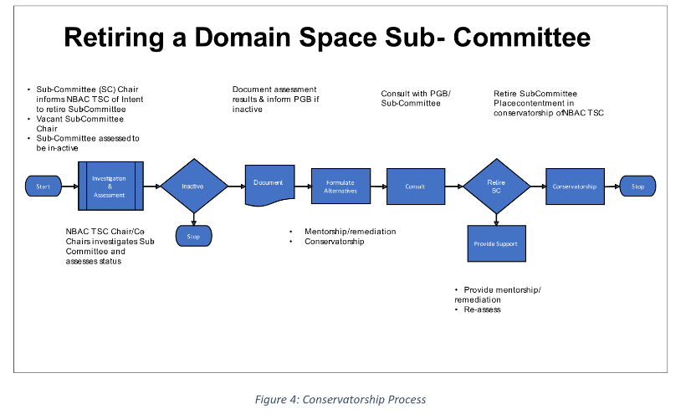
NBAC Governance, Roles & Responsibilities
Responsibilities:
Listed by Role
NBAC TSC Chair/Co-Chairs p.9-10
Domain Space Sub-Committee pp. 10-11
Harmonization Sub-Committee p. 11
Voting Members p. 11
PGB Expert Voting Members p. 11
At Large Members p. 11
Instantiating a Sub-Committee p. 13
Conservatorship pp. 13-14

Slide 9
Harmonization sub-committee Governance, Roles & Responsibilities
Reference Document (s):
(Approved) NIEMOpen NBAC TSC Governance (Rev2) v7 7-27-2023.dox : https://github.com/niemopen/nbac-admin/blob/main/documents/(APPROVED)%20%20NIEMOpen%20NBAC%20TSC%20Governance%20Doc%20(Rev%202)%20%20v7%20%207-27-2023.pdf

Slide 10
NMO Governance, Roles & Responsibilities
Reference Document (s):
NMO TSC Governance Document: https://github.com/niemopen/nmo-admin/blob/main/documents/NMO%20TSC%20Doc%209-26-2022%20rev%201.docx
Responsibilities: The NIEM Management Office (NMO) Technical Steering Committee (TSC) provides technical and administrative support to the NIEM Open Project Governing Board (PGB) Chair/Co-Chairs and by extension, PGB at large. This includes:
Administrative & clerical support functions
Audiovisual support
Site (s) administration as delegated by OASIS
Outreach staffing for NIEMOpen sponsorship and new NIEM Domain and new adopter engagement
Liaison support to NBAC & NTAC TSCs
Maintenance and creative support of NIEMOpen social media accounts:
LinkedIn (NIEM Community)
YouTube (/NIEMConnects)
Twitter (@NIEM)
Technical & Management Training support/ staffing
Technical Model Support/ staffing.

Slide 11
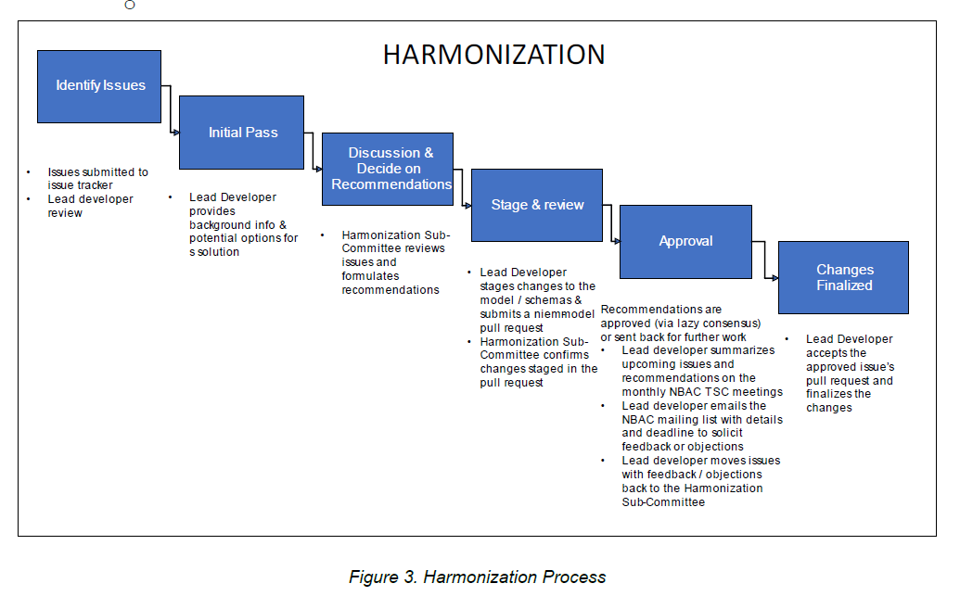
Harmonization SC Governance Governance, Roles & Responsibilities
Reference Document (s):
Harmonization SC Governance Document:
https://github.com/niemopen/nbac-admin/blob/main/harmonization-subcommittee/(FINAL%20)%20Harmonization%20Subcommittee%20Governance%20Doc%20v5%204-18-2023.pdf
Harmonization repo: established for v6.0
https://github.com/niemopen/nbac-admin/tree/main/harmonization-subcommittee

Slide 12
Backup

Slide 13




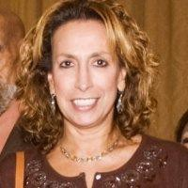

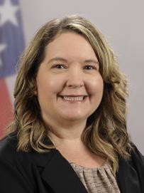
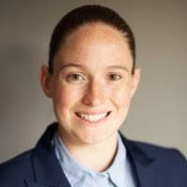
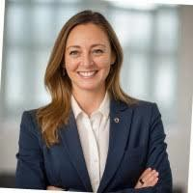

PGB APPOINTED VOTING MEMBERS
Ms. Katherine Escobar
PGB Chair Deputy Division Chief, Data and
Standards Division at Joint Staff J6 and NIEM Managing Director
Ms. Christina Bapst-Stump
Science and Technology Directorate,
US Department of Homeland Security
Mr. Gary Egner Director Business Development, Equivant
Mr. John Wandelt Principal Research Scientist, Georgia Tech Research Institute
Ms. Maria
Cardiellos Executive Director Integrated Justice Information Systems Institute
Mr. Payton Lamb Data Engineer Commonwealth of Virginia Office of the secretary of Administration
Office of Data Governance and Analytics
Ms. April Mitchell FBI It Specialist and Technical Lead of Data Standards in the Criminal Justice Information Services (CJIS) Division
Ms. Erin Partin Data Scientist, Office of the Principal Deputy Director, National Institute of Justice (NIJ)
Ms. Erica Smith Data Scientist, Unit Chief – Law Enforcement Incident-Based Statistics Unit, Bureau of Justice Statistics(BJS)
Mr. Tom Welch Director of Information Technology OHIO HIDTA –
Including Northern KY & Western PA

Slide 14
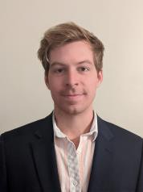

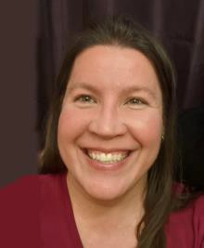



PGB EXPERT VOTING MEMBERS & NON-VOTING MEMBERS
PGB EXPERT VOTING MEMBERS
Technical Steering Committees
PGB EXPERT NON-VOTING MEMBERS
Technical Steering Committees
Mr. Kamran Atri Co-Chair, NIEM Business Architecture Committee TSC
Mr. Paul Wormeli Co-Chair, NIEM Business Architecture Committee TSC
Mr. Brad Bolliger Co-Chair, NIEM Technical Architecture Committee TSC
Mr. Thomas Krul Co-Chair, NIEM Business Architecture Committee TSC
Ms. Darcy Staley Co-Chair, NIEM Management Organization TSC
Dr. Scott Renner Co-Chair, NIEM Technical Architecture Committee TSC

